Slide 1
SPORTS WAY
The way towards your dream sport
BY TEAM-6
Under the guidance of J.MRUDHULA

Slide 2
TEAM MEMBERS
P.Sowjanya - O190145
K.Hema - O190303
M.Kiran - O190524
P.Bharathi - O190241
N.Sandhya Rani - O190906

Slide 3
CONTENTS
Abstract
Objectives
Existing System
Proposed System
Requirements
Advantages and Disadvantages
UML Diagrams
Description of proposed work
Result
Future Scope
Conclusion

Slide 4
Abstract
In the modern era, sports enthusiasts wishes to buy the best sports shoes. In order to buy them, they have to search various resources, which will consumes the time and they may not find quality products.
Our project Sports way is the solution designed to cater the needs of active individuals and athletes.
This website is engineered to deliver a seamless and user-friendly interface by providing a comprehensive selection of athletic footwear for various sports disciplines like basketball,football, and running.

Slide 5
Objectives
User convenience
Diverse product range
Accessibility
Efficient and time saving
Detailed product information
Responsive customer support

Slide 6
Existing System
In existing system customer has to go to an e-commerce website which consists of different categories.
It is time consuming for the customers to search and select their ideal shoes.

Slide 7
Proposed system
The proposed system offers an extensive catalogue of athletic footware which offers 24/7 accessibility, allowing users to browse, compare and order sports shoe at any time and from anywhere, eliminating the need for physical store visits.
The proposed system provide customers with unparalleled convenience.
It saves lot of time and effort by helping the customers to select their ideal shoes among different types of shoes.
The platform will enable users to easily select shoes based on size, sport type, brand and price range.

Slide 8
Requirements
Software Requirements:
HTML
CSS
JavaScript
Bootstrap
PHP
MYSQL

Slide 9
Hardware Requirements:
Processor
Hard Disk
RAM
Laptop
Monitor
Keyboard
Mouse

Slide 10
Advantages
User convenience
Diverse product range
Accessible
Efficient and time saving
Responsive customer support

Slide 11
disAdvantages
It’s not an app
Not scalable
Only limited products
Limited payment methods
No return option

Slide 12
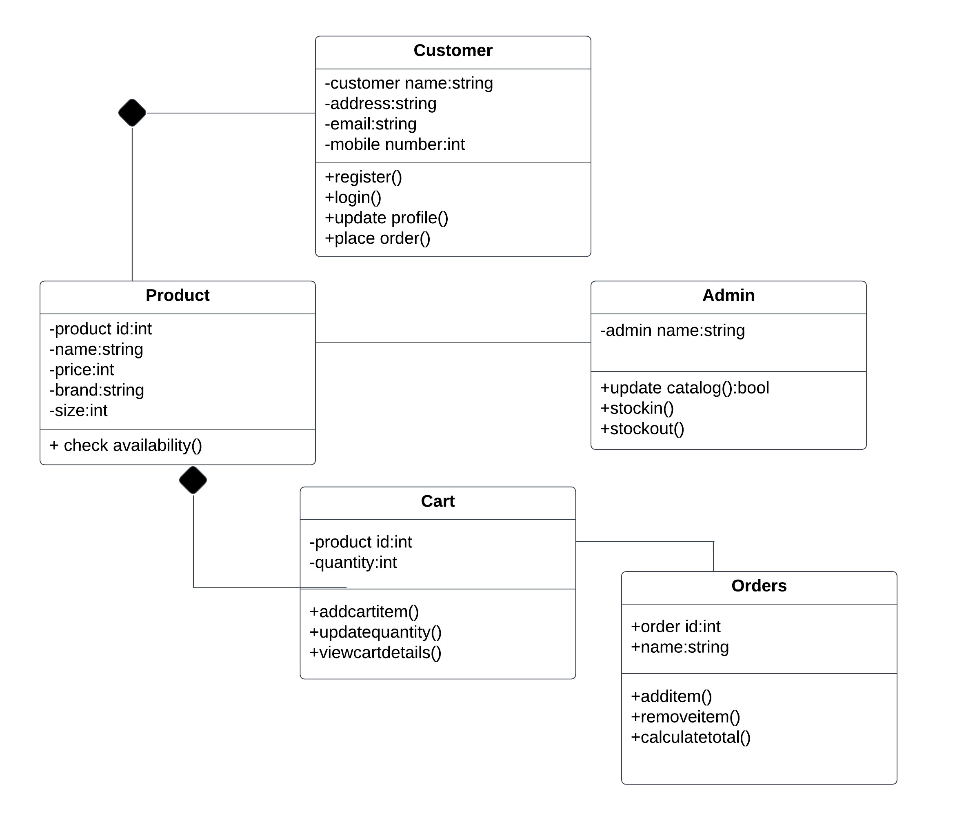
UML Diagrams
Class diagram

Slide 13
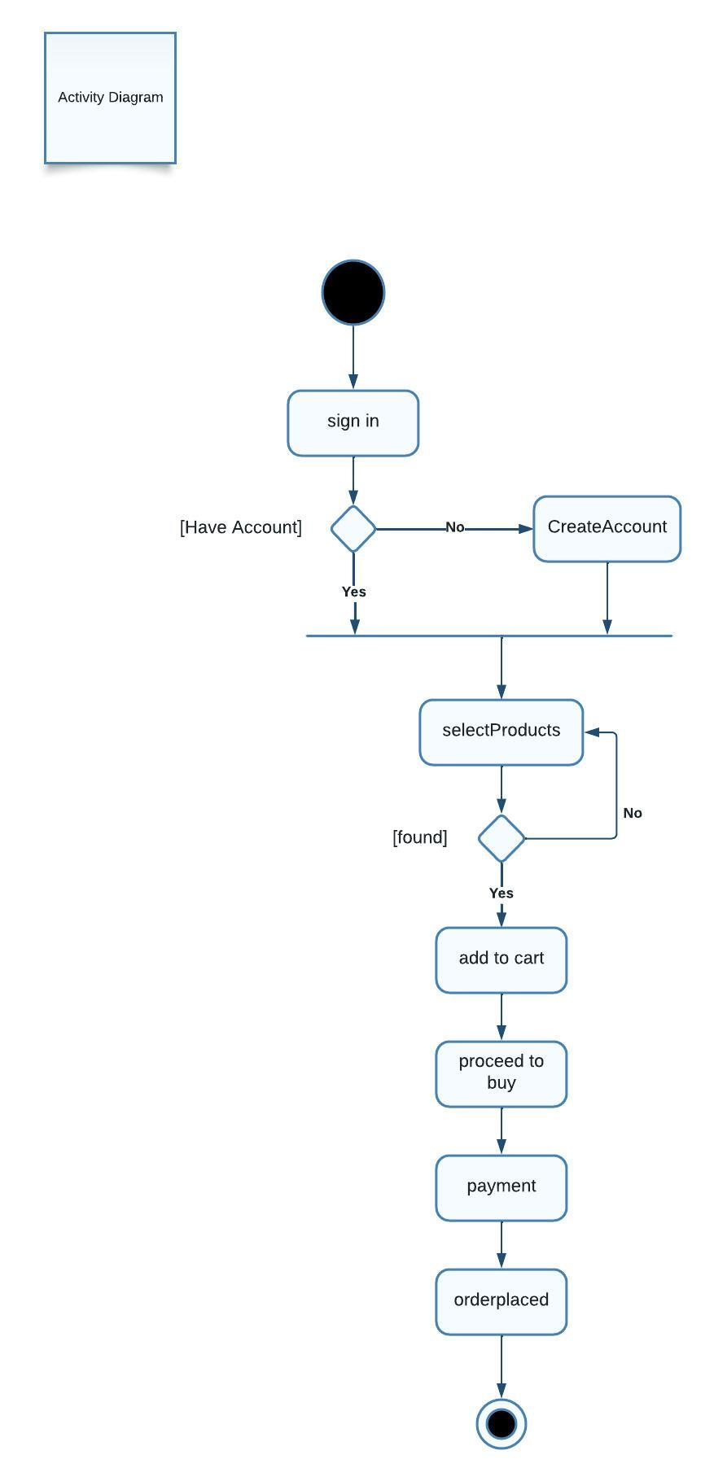
Activity diagram

Slide 14
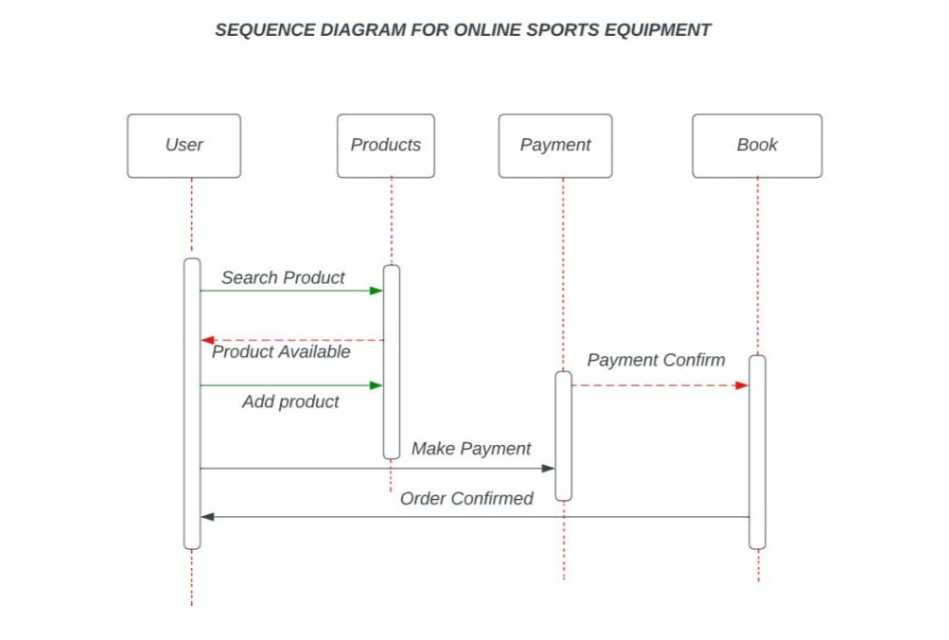
Sequence diagram

Slide 15
Description
User login
User will be allowed with a valid User ID & Password
Product categories
It consist of different categories of shoes like football, basketball and running
Contact us
User can ask queries in this module and those queries will reach to the admin
Admin
Admin can see the customers who are logged in, update stock in and stock out items and view the user queries

Slide 16
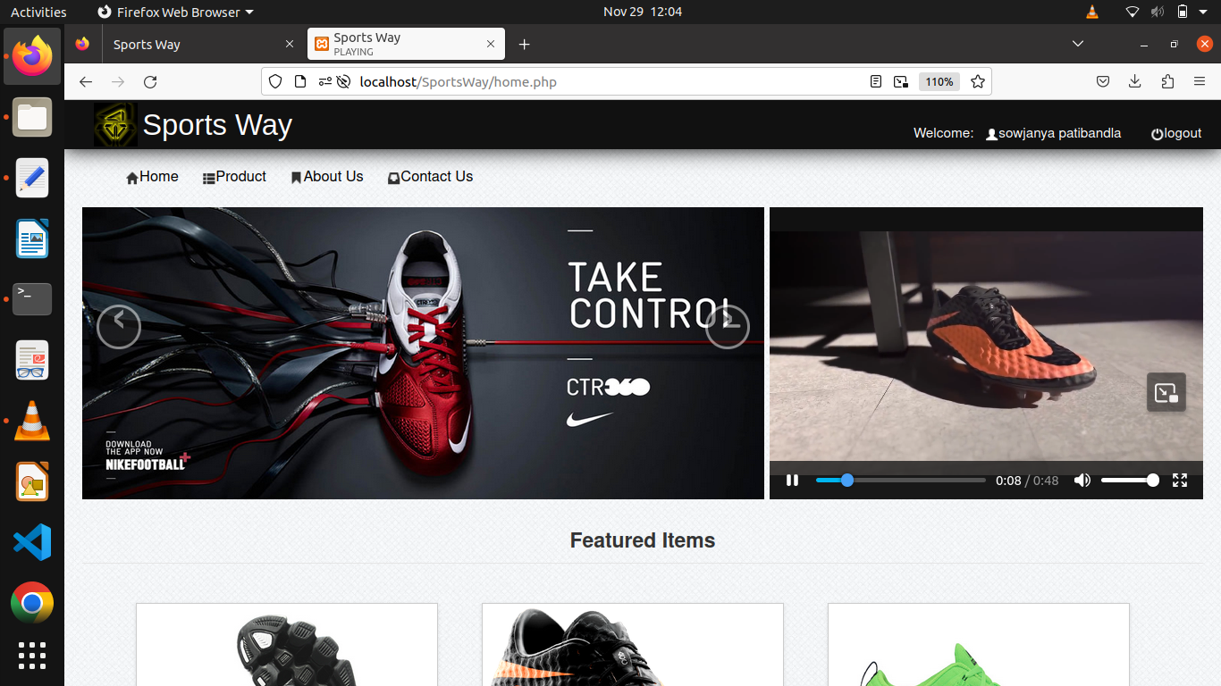
Result

Slide 17
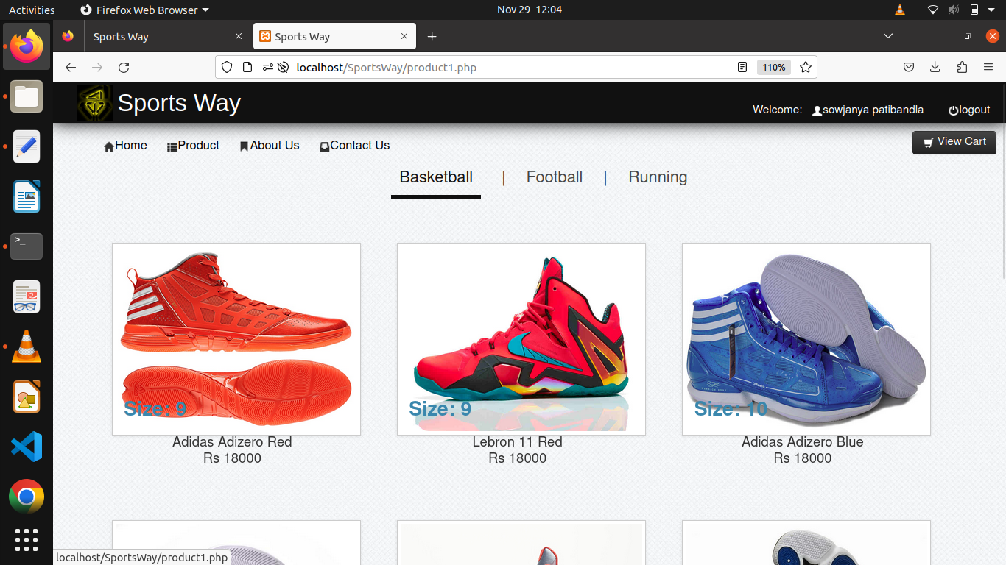

Slide 18
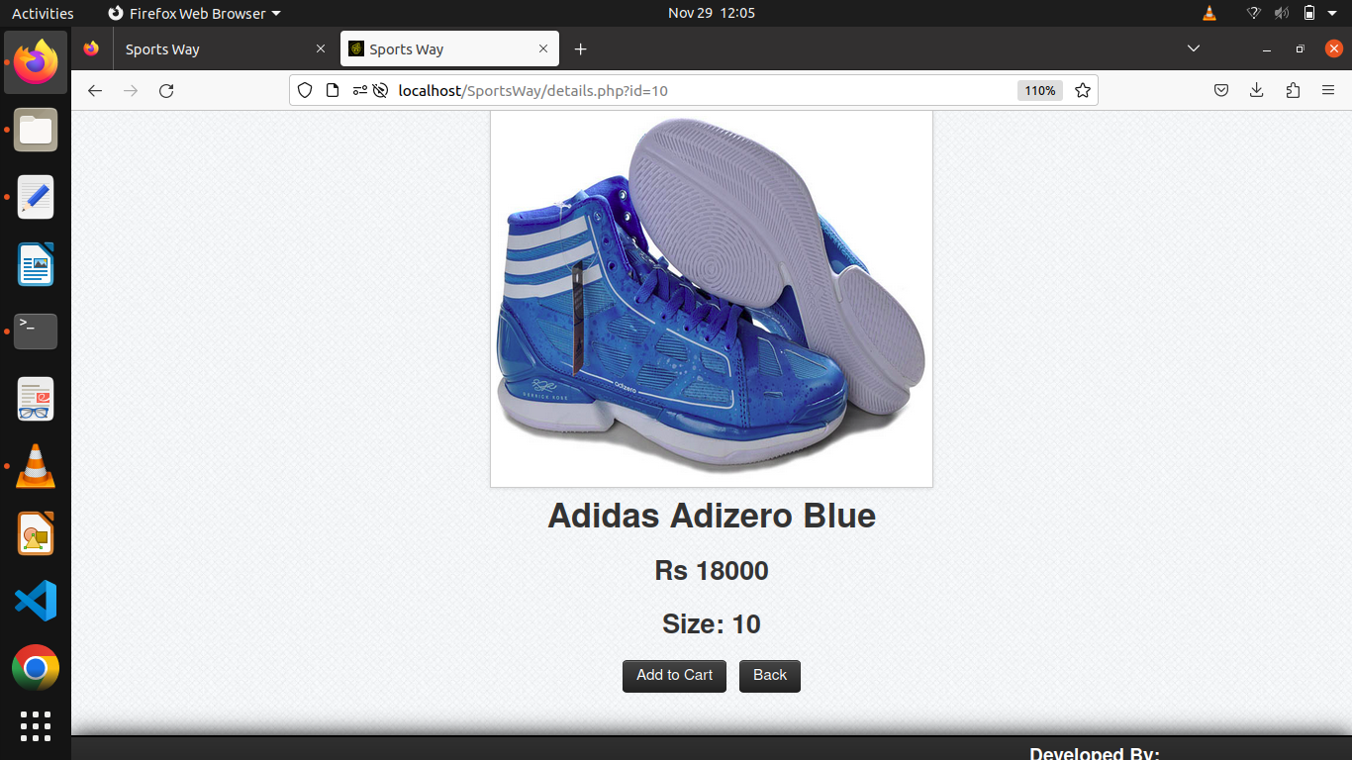
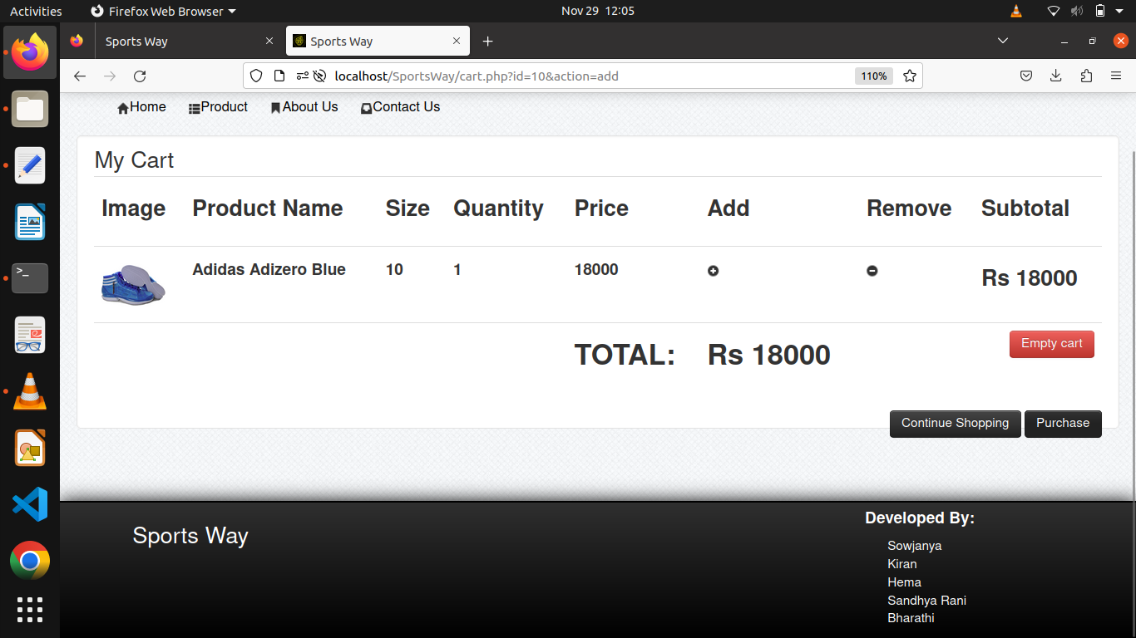

Slide 19
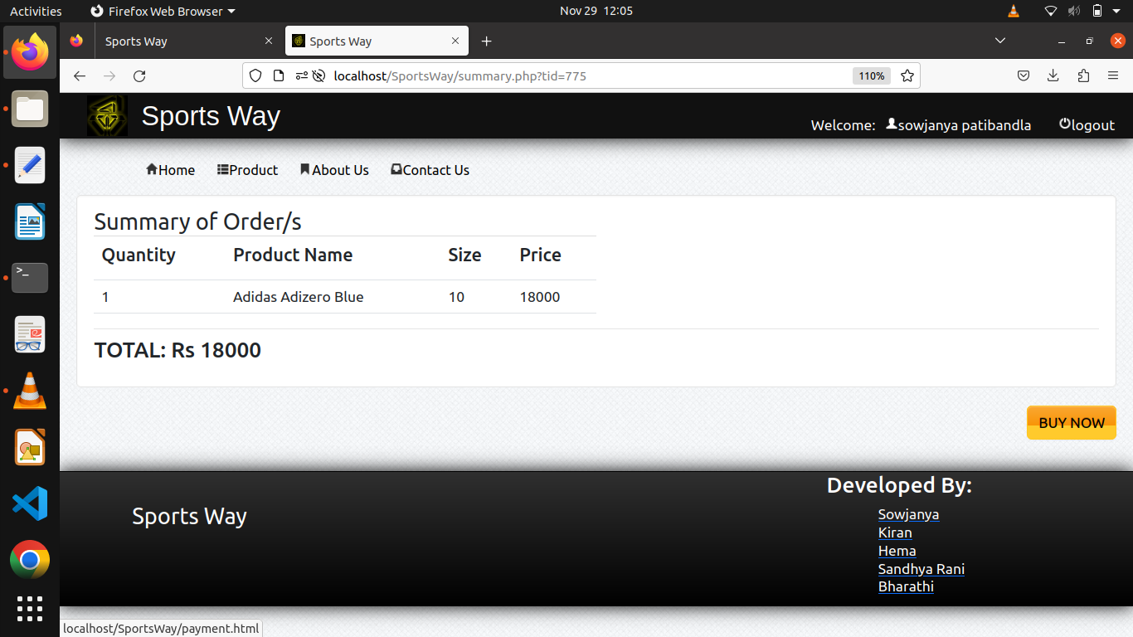
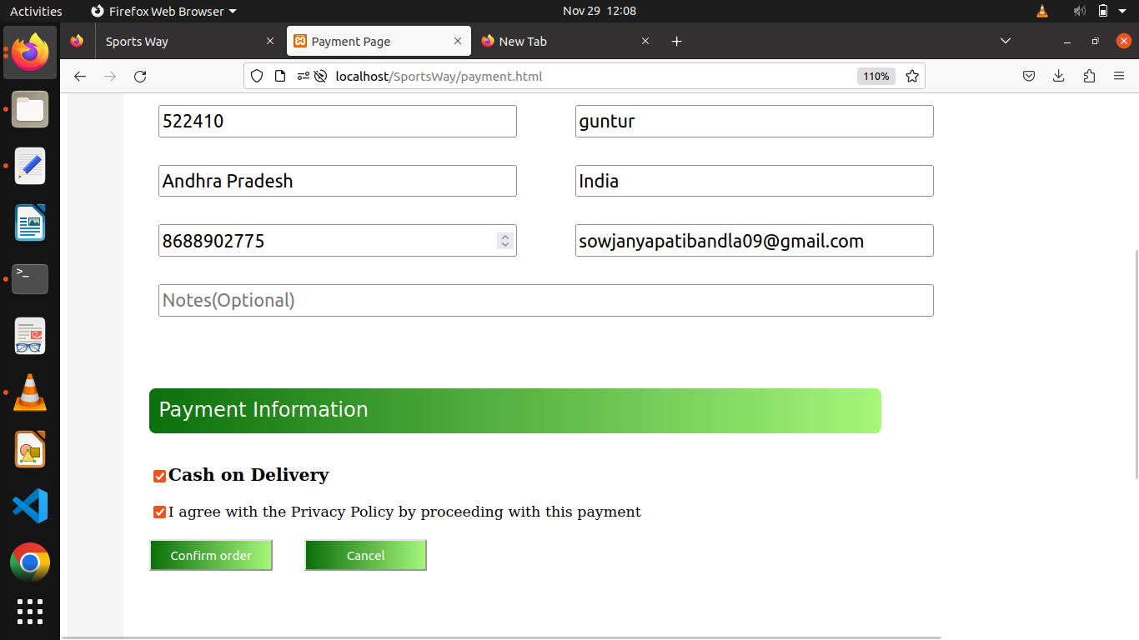
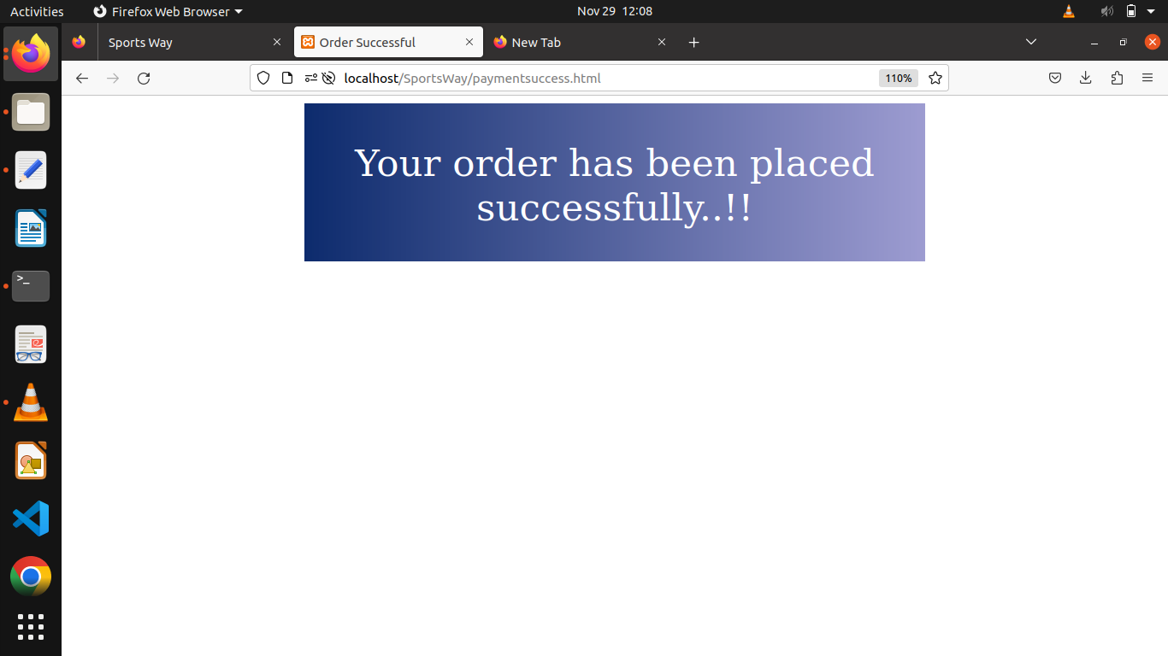

Slide 20
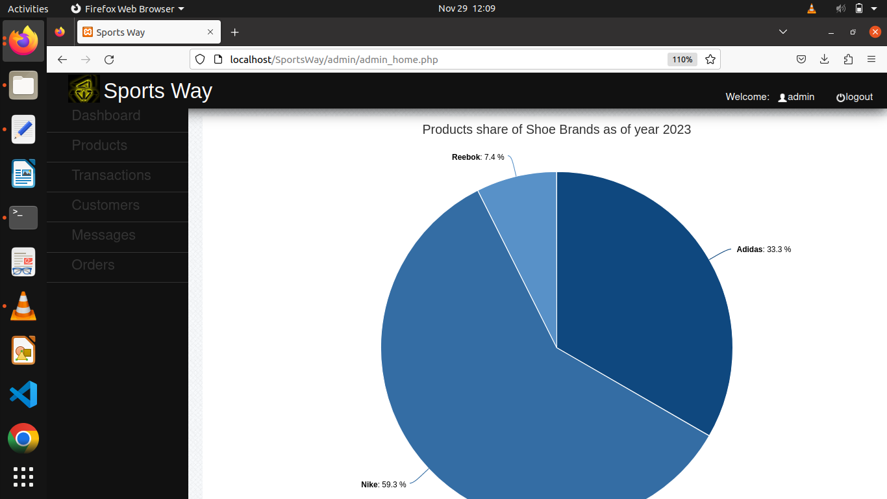
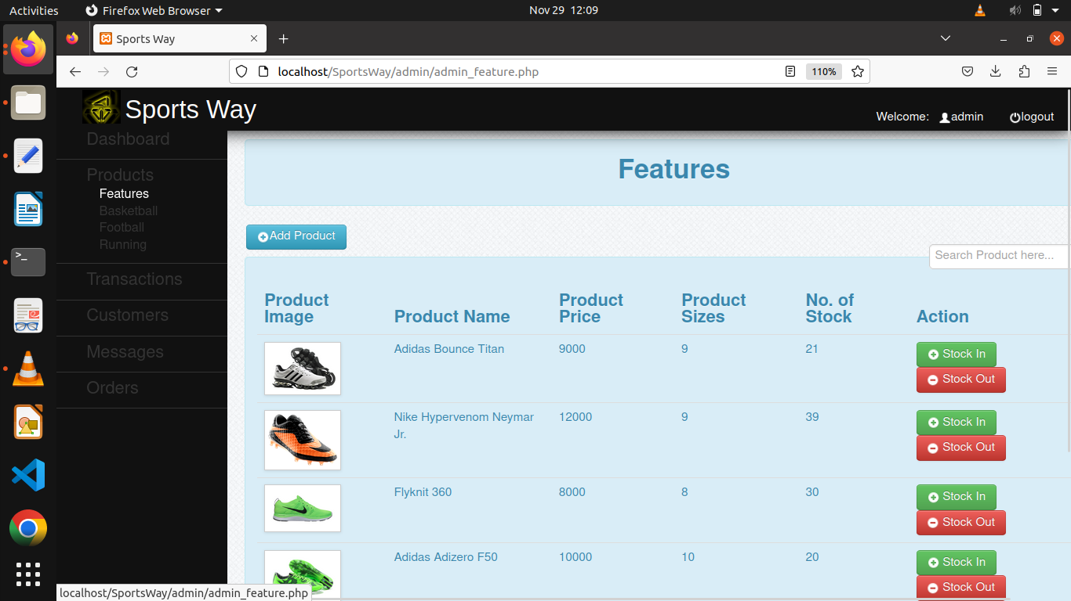

Slide 21
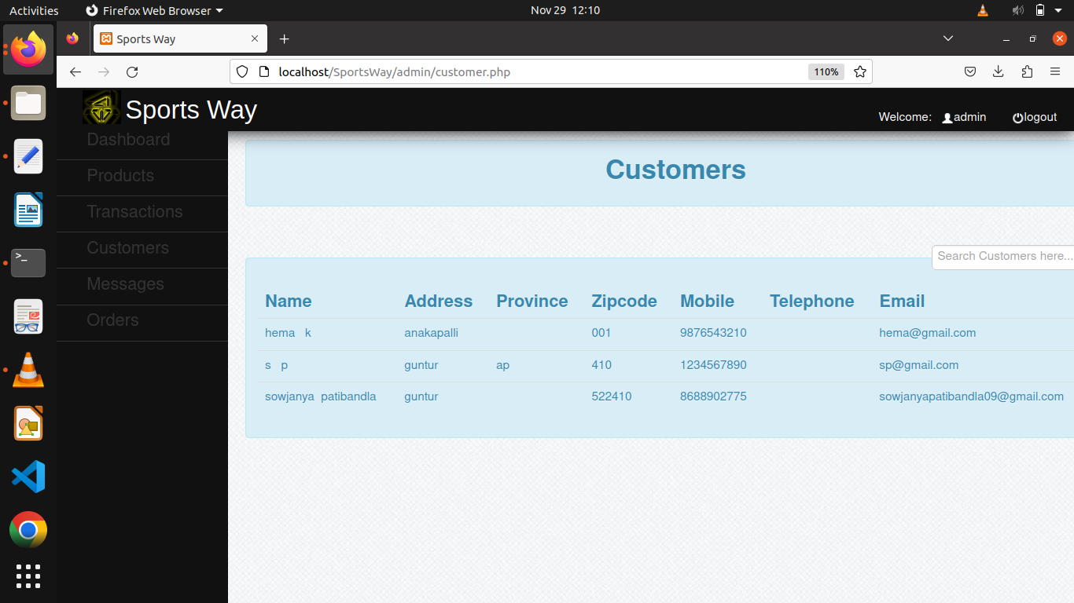
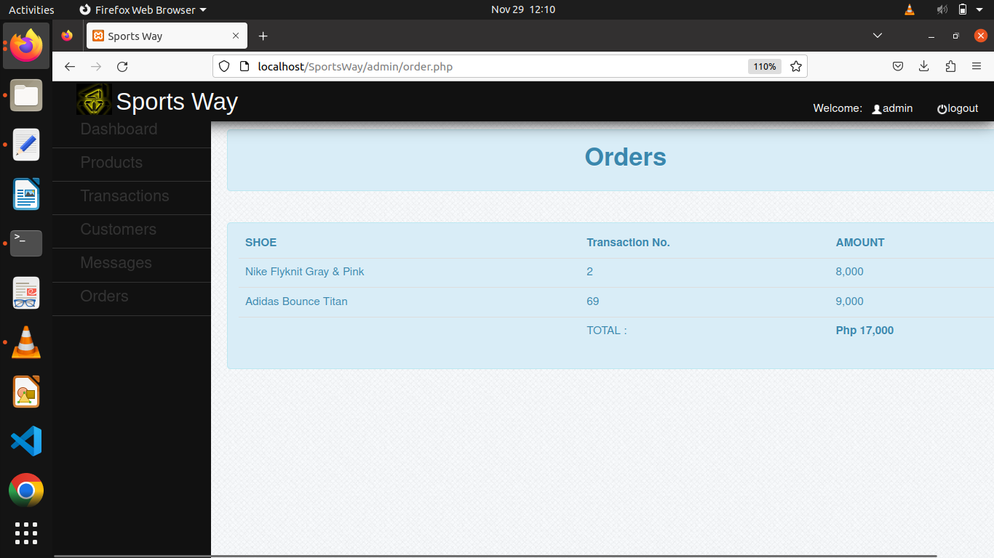

Slide 22
Future scope
Augmented Reality Virtual Try-on
Custom shoe design
Local store integration
Accessibility Features
Reviews
Advanced search and filtering

Slide 23
Conclusion
The sports way website offers a convenient platform for users to explore and purchase athletic footwear with a user friendly interface.
This website aims to provide a more convenient and accessible shopping experience by offering a diverse catalogue of sports shoes for different sports and activities.
Customers can easily select their ideal sports shoes to enhance their performance.

Slide 24
Thank you

